Slide 1
Evolution of the sporophyte in Brophytes
G.Swapna
Lecturer in Botany
DRG Govt Degree College
Tadepalligudem

Slide 2
Content
Introduction
Theory of Sterilization
Reduction Theory

Slide 3
Introduction
The sporophyte of liverworts and mosses show mostly the same fundamental plan.
It is made up of an anchoring and absorbing foot,a stalk- like
seta and a capsule, which contains spores and elaters.
The following two contrasting views have been put forword with regard to the evolution of sporophytes in bryophytes:-
Evolution of sporophytes by progressive sterilization of
potential sporogenous tissue.
Evolution of sporophyte due to progressive reduction or simplification.

Slide 4
Theory of sterilization
Sporogenous Tissue:-
This view , also known as 'theory of progressive evolution 'or 'theory of sterilization ',was put forward by Bower (1908-35) and supported by cavers (1910) and Campbell (1940).
According to this view ,the sporophytes of complex forms (e.g.,Funaria ,Sphagnum
,Pogonatum) have evolved due to progressive sterilization of the potential fertile tissue of the simpler forms (e.g.,Riccia, Marchantia).

Slide 5
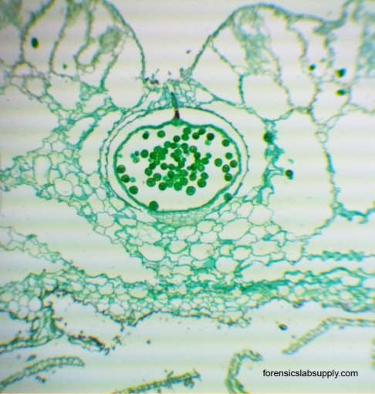
First stage
The simplest known sporophyte among Bryophtes is that of Riccia.
In all species of Riccia ,the sporophyte consists of only capsule ,there being no trace of seta and foot.
The oospore ( the mother cell of the sporophyte ) divides first by a transverse and then by a vertical wall to form a four - celled embryo which becomes 20-30 celled by further division
.
Occasionally , a few cells fail to develop into spores and these sterile cells( nurse cells) have nutritive function and are supposed to be the ancestors of elaters.

Slide 6
Second Stage
In Corsinia , the oospore divides by a transverse wall into a hypobasal and an epibasal cell.
The former gives rise to a small foot.
The derivatives of the epibasal cell from an outer amphithecium and an inner endothecium.
Thus in the sporophyte of Corsinia the sterilization has gone a step further and in addition to nurse cells, a sterile foot is also present.

Slide 7
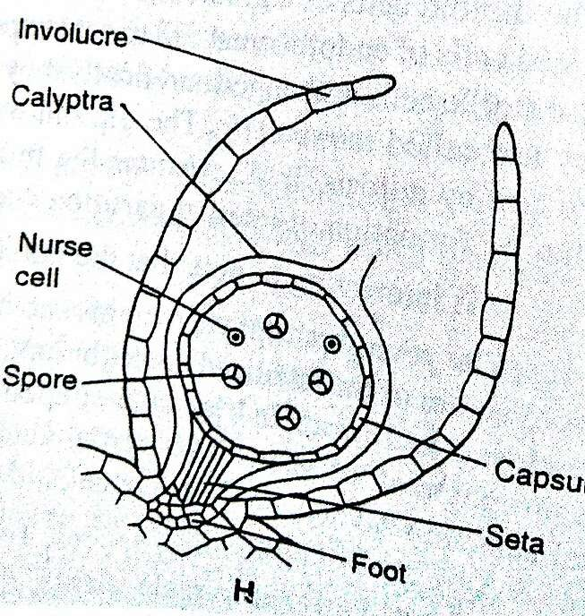
Third Stage
Further sterilization is seen in spharocarpus where the sporophyte has a sterile bulbous foot and a narrow seta, in addition to fertile capsule.
The amphithecium forms a single layered jacket of the capsule and the endothecium
,the sporogenous tissue and the sterile nurse cells.

Slide 8
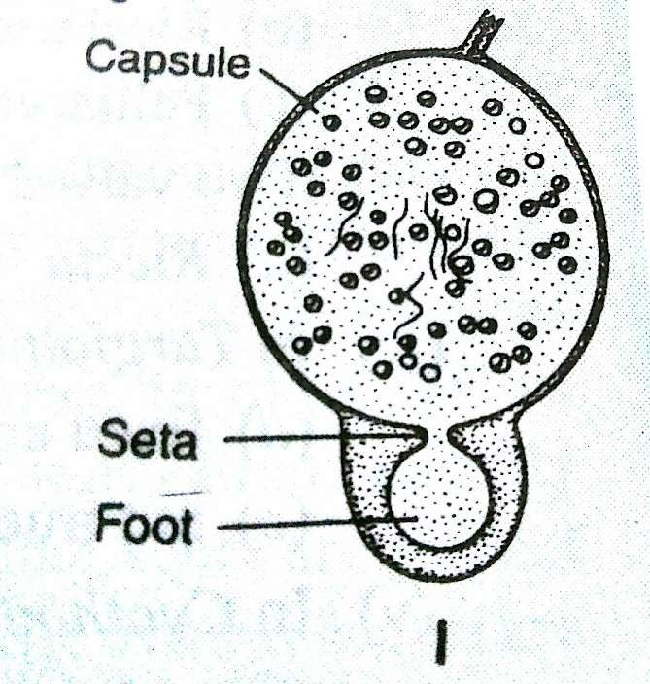
Forth Stage
In Targionia,the sporophyte is differentiated into a bulbous foot ,a massive seta and a capsule.
The amphithecium gives rise to a single layered jacket of the capsule and only about half of the endothelial cells give rise to fertile sporogenous tissue and the remaining half form sterile skaters.
Thus in the sporophyte of Targionia there is still further sterilization of sporogenous tissue in comparison to Riccia,Corsinia,Sphaerocarpus.

Slide 9
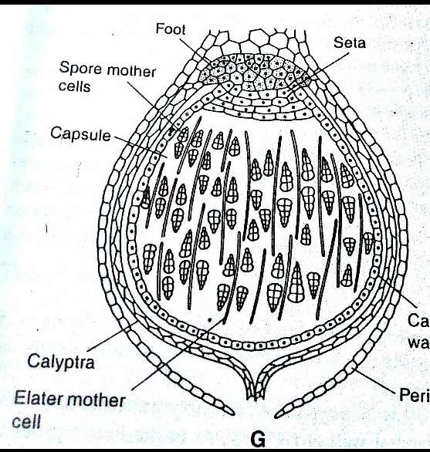
Fifth Stage
In Marchantia , the lower half (hypobasal cells) of the octant embryo froms the foot,and seta and the upper half (epibasal cells ) the capsule.
Approximately 50 percent of the sporogenous cells form spores and the remaining 50 percent elaters with characteristic thickening bands.
Thus,a bulbous foot,an elongated seta , a single layered capsule wall and large number of elaters are sterile constituents of the sporophytes of Marchantia.

Slide 10
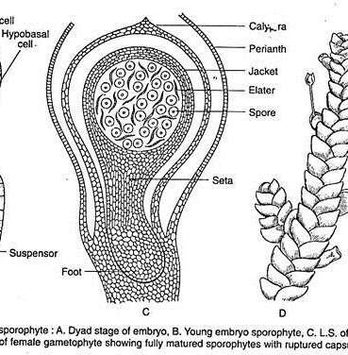
Sixth Stage
Further sterilization of the sporophytic tissue can be seen in Pellia.
The sporophyte of Pellia is also differentiated into foot,seta and capsule as in Marchantia but the jacket of the capsule is two or more layered.
Furthermore , a fixed sterile elaterophore is present at the proximal end of the capsule with a bunch of elaters.

Slide 11
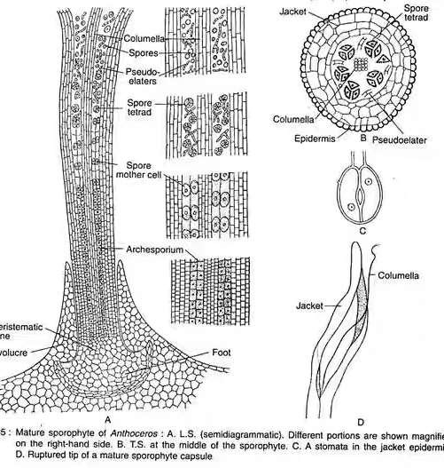
Seventh Stage
The sporophyte of Anthoceros is of great interest from the point of view of evolution .
The mature sporophyte consists of a bulbous foot and horn or bristle -like capsule.
The elaters of Anthoceros are known as pseudoelaters as they do not possess thickening bands.
Thus , from the point of view of sterility and self- dependence , the sporophyte of Anthoceros is more specialized than those of Hepaticopsida.

Slide 12
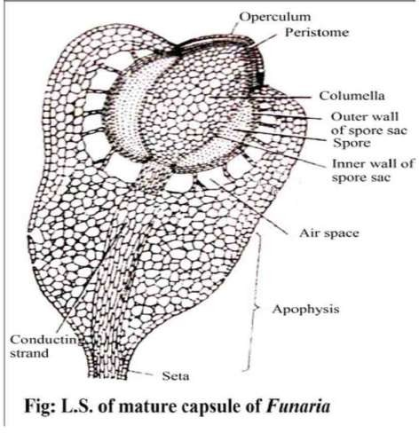
Eighth Stage
The highest degree of sterilization of the sporophyte is found in the class Bryopsida.
The regions like foot, seta,capsule wall, columella, apophysis
,operculum and peristome in the Bryophyta .
Funaria,Politrichum and Pogonatum represent the sterile tissue.

Slide 13
Thus the sporophyte of Riccia is the simplest amongst the bryophytes, with a very high proportion of fertile tissue and the sterile tissue is very small.
On the other hand , the members of the class Bryopsida (e.g.,Funaria,Polytrichum , Pogonatum ) have the most complex sporophyte with a very high degree of sterility.
The evolution of sporophyte in bryophytes as such is considered to have taken place by progressive sterilization of the fertile tissue .

Slide 14
Reduction Theory
There is however, an -opposite school of thought led by Kashyap,Church,Goebel and Evans.
They hold that so serlated the evolution of the sporophyte has been in the downward direction
.
The series they believe furnishes an example of retrogressive evolution.
There is ample evidence of reduction rather than progressive elaboration of the sporophytes of this group.

Slide 15
The significant steps in the reduction series are:-
Simplification of the dehiscence apparatus.
Reduction of the green photosynthetic tissue in the capsule wall.
Associated with the above is the disappearance of stomata and intercellular spaces.

Slide 16
Side by side with the above changes in the gradually elimination of the seta and subsequently the disappearance of the foot.
All these changes are accompanied by the progressive increase in the fertility of the sporogenous cells.
Evidence from comparative morphology and experimentaly genetics support the view that the simple sporophyte of Riccia is an advanced but a reduced structure.

Slide 17
Reference
Botany For Degree Students Bryophytes by:-
B. R. Vashistha
A. K.Sinha
V. P. Singh
https://en.m.wikipedia.org
https://www.slideshare.net

Slide 18
Thank You

